Slide 1
LEADER Programme for Connemara
Rural Development Programme 2014-2020
Notes:
The purpose of this meeting tonight is to ask you the local community (including voluntary groups, businesses, youth groups, active retirement groups, the public) to help us identify the challenges & opportunities of the local area – be it economic, social, environmental.
There is no leader programme operating nationally….

Slide 2
Strategic Vision
‘Connemara will realise its potential, providing opportunities for all to grow and participate in the economic, social and civic life of the region and use its unique strengths and attributes to develop the local economy, ensure a ‘living landscape’ with a strong and inclusive community.’

Slide 3
FORUM & THE LEADER PROGRAMME
FORUM was established in 1990 to administer social and community development programmes
FORUM has administered the EU LEADER Programme since 2009 with €5m in grant aid for enterprise & community development
Notes:
Who we are? FORUM is a rural development partnership of voluntary, community and a statutory body based in Connemara, with the objective of putting in place strategies and programmes to tackle the problem of rural decline and peripherality.
25 years experience of community led local development
20 Full time core staff & 2 part-time
149 Number of people on Community Employment (CE), Rural Social Scheme (RSS), Job Initiative and TÚS schemes - 80 Full time equivalents
FORUM administers other programmes which compliment each other:
Last LEADER Programme 2007-2013 in non Gaeltacht Connemara
Local Community Development Programme (LCDP) in all of Connemara since 2012
Adolescent Support Programme
FAS Community Employment Schemes x 3
FAS Job Initiative Scheme
Rural Social Scheme
TUS Scheme x 4
Rural Recreation Scheme in all of County Galway
The last LEADER programme
Range of projects - including micro - enterprises, community facilities, heritage projects, tourism

Slide 4
Outputs of last programme
88 people in part-time employment
187 people in part-time & temporary employment
32 people in full time employment

Slide 5
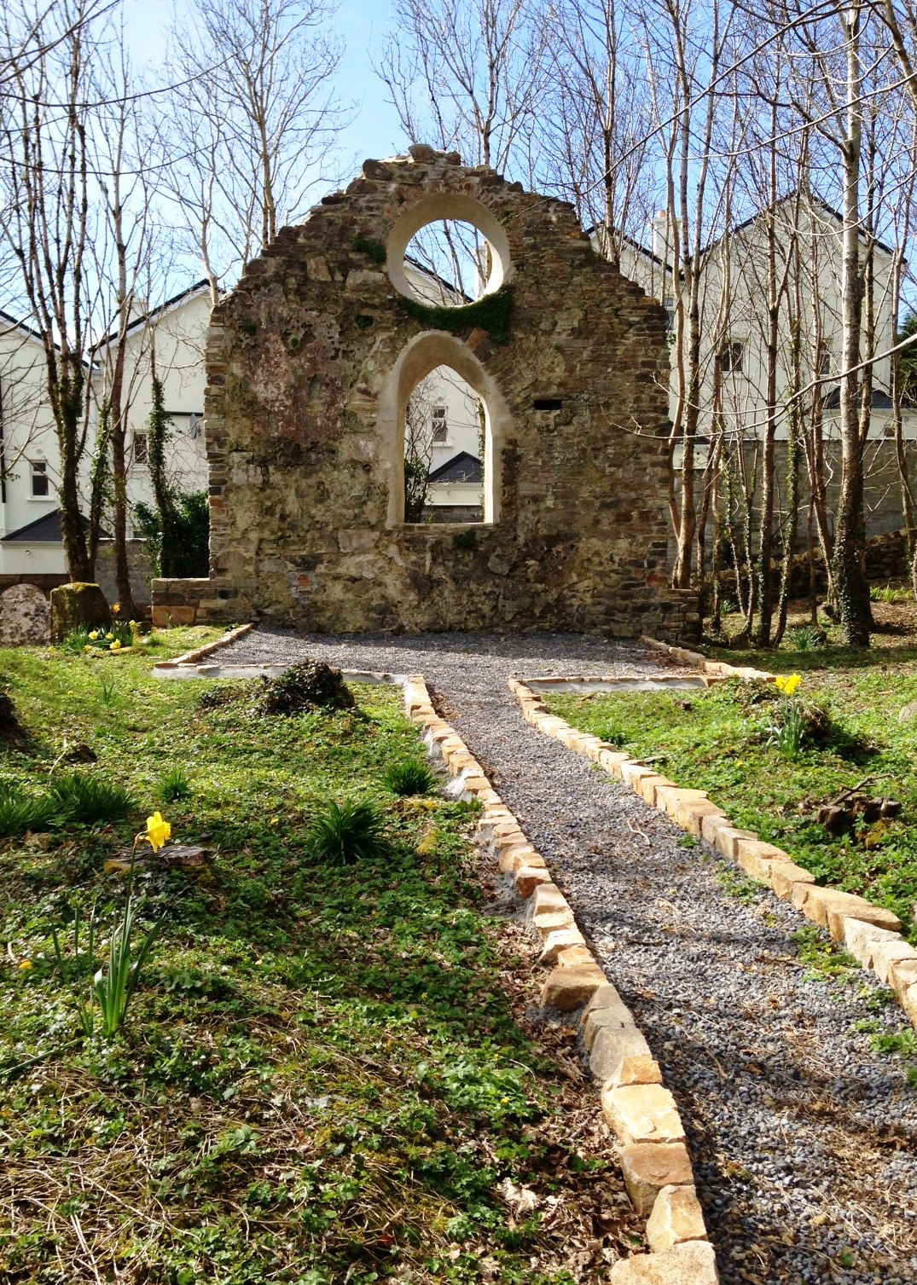
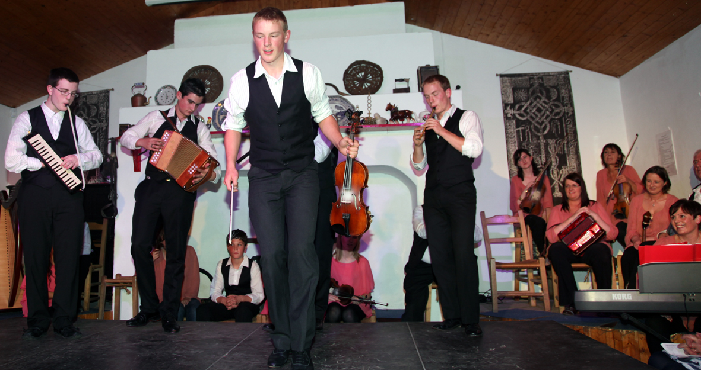
Projects from previous programme
Supporting Traditional Music, Song & Dance Projects
Supporting heritage
St. Mary’s church & graveyard

Slide 6
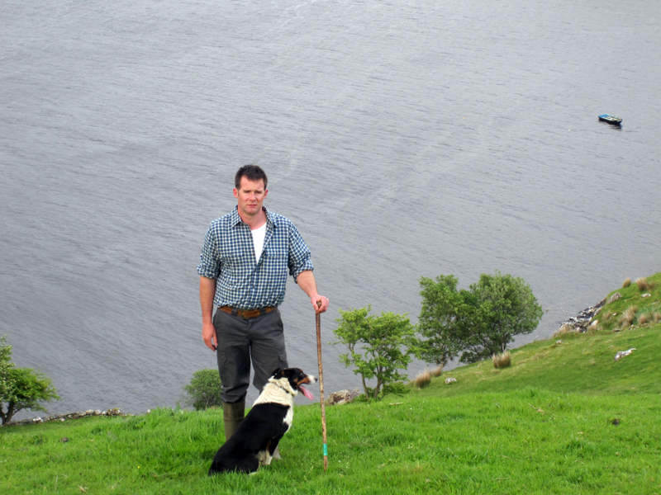
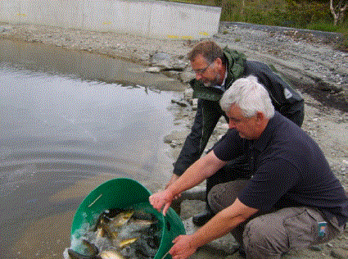
Projects from previous programme: Rural Enterprise
Left: Tom Nee of
Killary Sheep Farm
Right: Mike Faherty Oughterard Fishing Ponds

Slide 7
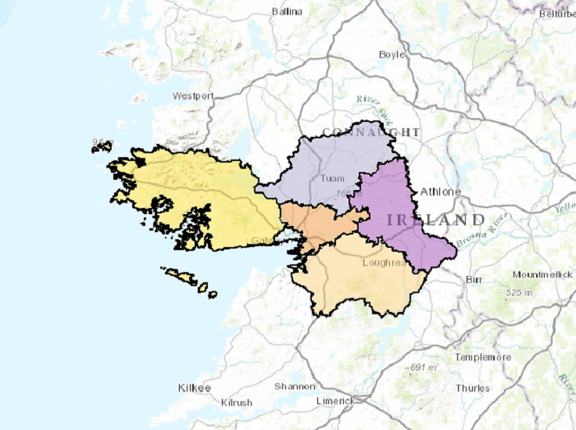
Geographical area: Connemara Municipal District

Slide 8
LEADER Approach & Budget
Project budget is €3.45m for area
National Budget last time - €427m
National Budget this time - €220m
Notes:
The CLLD approach - the idea is that this single methodology will allow for connected and integrated use of the European Structural Funds to deliver the local development strategies.
Bottom up approach rather than government to-down approach
This is the LOCAL ACTION GROUP (LAG) model (public & private stakeholders) - voluntary Board of FORUM
(Composition of LAG - 51% of Board is from the non state sector)
Staff are now carrying out a integrated and multi-sectoral area-based local development strategies/plan
designed taking into consideration local needs and potential;
includes innovative features in the local context,
networking and, where appropriate, co-operation (transnational projects – other partners in the EU)
THIS IS YOUR PLAN

Slide 9
Roll out of LEADER in Connemara
Public information sessions in co-operation with National Rural Network (Maam Cross 1st Feb 2017) and targeted/focus consultations to be agreed later when we have full staff compliment
Open for expression of Interest Forms for 4 Strategic Actions on 1/2/17 and closed on 28/2/17
Notes:
Meeting will be a max. of 2 hours

Slide 11
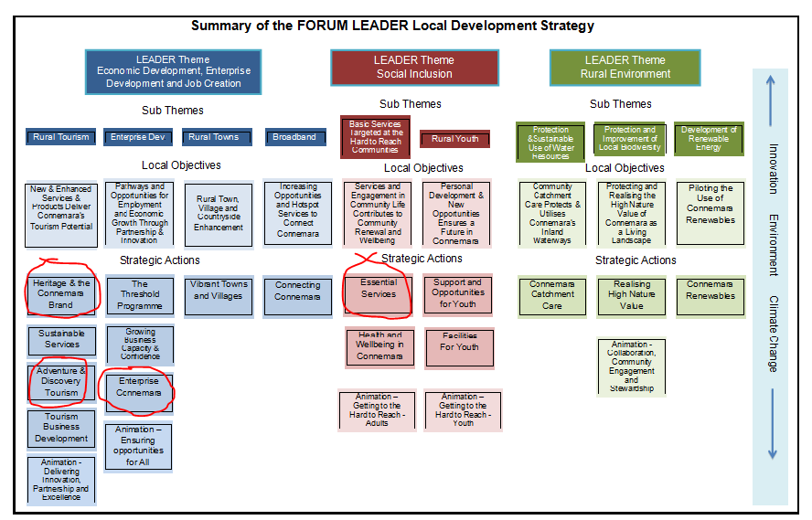

Slide 12
Strategy Group Recommendations
4 strategic actions – targeted calls:
Adventure and Discovery Tourism €130,000
Heritage and the Connemara Brand €100,000
Enterprise Connemara - €100,000
Essential Services - €300,000
Total Budget for this call €630,000

Slide 13
Adventure and Discovery Tourism
Examples of Projects that may be funded:
Projects that leverage the natural physical assets and environment of the area in a sustainable fashion
Projects that leverage the cultural assets and heritage of the area to cerate a tourism experience

Slide 14
Adventure and Discovery Tourism
More examples of projects that may be funded:
Interpretative projects that inform and provoke interest in the natural physical and cultural heritage of the region
Projects that add value to existing key tourism infrastructure such as the WAW, Blueway and Green way
Trail development for walking, mountain biking, horse riding
Agri-Toursim projects that diversify the farm income

Slide 15
Heritage & the Connemara Brand
Examples of Projects that may be funded:
Community based festivals and events
Activities that reinforce the heritage and culture of the region- particularly around traditional music, song and dance
Community based Irish language activities
Projects that add value to existing key tourism infrastructure i.e. WAW, Blueway, Western Way etc.

Slide 16
Enterprise Connemara
Examples of Projects that may be funded:
Priming grants
Capital support for new businesses to purchase equipment refurbish buildings etc.
Capital support to existing businesses that will allow them to expand or develop new levels of excellence in their industry

Slide 17
Enterprise Connemara
Intangible investments such as the acquisition or development of computer software and acquisitions of patents, licenses, copyrights, trademarks as long as they are integral to the development of a wider business and will lead to job creation in the region
Prototype development

Slide 18
Essential Services
Examples of Projects that may be funded:
Development of services and supports for disadvantaged and marginalised groups that can demonstrate sustainability
Innovative projects that provide solutions to emerging social problems for vulnerable groups

Slide 19
Essential Services
More examples of projects that may be funded:
Funding for upgrading community kitchens
Innovative community-led local transport solutions
Refurbishment and upgrading of community infrastructure

Slide 20
Thank you
www.forumconnemara.ie
info@forumconnemara.ie
Facebook - @FORUMConnemaraCLG
Twitter @FORUMConnemara
Letterfrack, Connemara, Co. Galway
095-41116

